Slide 1

APACHE AIRFLOW
Made By :
Navdeep Singh
navdeepsinghrehsi@gmail.com
9654441007

Slide 2
Introduction
Airflow is a platform to programmatically author, schedule and monitor workflows.
Use airflow to author workflows as directed acyclic graphs (DAGs) of tasks. The airflow scheduler executes your tasks on an array of workers while following the specified dependencies.
The rich user interface makes it easy to visualize pipelines running in production, monitor progress, and troubleshoot issues when needed.
When workflows are defined as code, they become more maintainable, versionable, testable, and collaborative.

Slide 3
Principles
principles
Dynamic
Elegant
Scalable
Extensible

Slide 4
Description
Dynamic: Airflow pipelines are configuration as code (Python), allowing for dynamic pipeline generation. This allows for writing code that instantiates pipelines dynamically.
Extensible: Easily define your own operators, executors and extend the library so that it fits the level of abstraction that suits your environment.
Elegant: Airflow pipelines are lean and explicit. Parameterizing your scripts is built into the core of Airflow using the powerful Jinja templating engine.
Scalable: Airflow has a modular architecture and uses a message queue to orchestrate an arbitrary number of workers. Airflow is ready to scale to infinity.

Slide 5
History
Airflow was started in October 2014 by Maxime Beauchemin at Airbnb.
It was open source from the very first commit and officially brought under the Airbnb Github and announced in June 2015.
The project joined the Apache Software Foundation’s incubation program in March 2016.

Slide 6
Airflow nomenclature
Airflow DAGs are composed of Tasks.
Each Task is created by instantiating an Operator class. A configured instance of an Operator becomes a Task, as in: my_task = MyOperator(...).
When a DAG is started, Airflow creates a DAG Run entry in its database.
When a Task is executed in the context of a particular DAG Run, then a Task Instance is created.
AIRFLOW_HOME is the directory where you store your DAG definition files and Airflow plugins.

Slide 7
Architecture
A rich CLI (command line interface) to test, run, backfill, describe and clear parts of your DAGs.
A web application, to explore your DAGs definition, their dependencies, progress, metadata and logs. The web server is packaged with Airflow and is built on top of the Flask Python web framework.
A metadata repository, typically a MySQL or Postgres database that Airflow uses to keep track of task job statuses and other persistent information.
An array of workers, running the jobs task instances in a distributed fashion.
Scheduler processes, that fire up the task instances that are ready to run.

Slide 8
Concepts
DAGs
In Airflow, a DAG – or a Directed Acyclic Graph – is a collection of all the tasks you want to run, organized in a way that reflects their relationships and dependencies.
DAGs are defined in standard Python files that are placed in Airflow’s DAG_FOLDER. Airflow will execute the code in each file to dynamically build the DAG objects.
You can have as many DAGs as you want, each describing an arbitrary number of tasks. In general, each one should correspond to a single logical workflow.

Slide 9
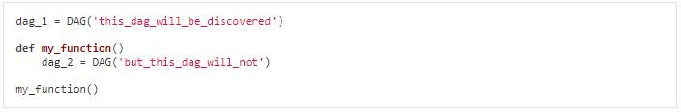
Scope
Airflow will load any DAG object it can import from a DAGfile. Critically, that means the DAG must appear in globals(). Consider the following two DAGs. Only dag_1 will be loaded; the other one only appears in a local scope.
Sometimes this can be put to good use. For example, a common pattern with SubDagOperator is to define the subdag inside a function so that Airflow doesn’t try to load it as a standalone DAG.

Slide 10
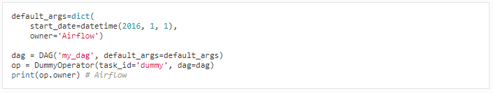
Default Arguments
If a dictionary of default_args is passed to a DAG, it will apply them to any of its operators. This makes it easy to apply a common parameter to many operators without having to type it many times.

Slide 11
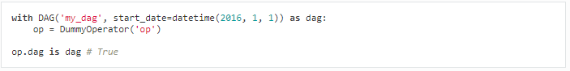
Context Manager
DAGs can be used as context managers to automatically assign new operators to that DAG.

Slide 12
Operators
An operator describes a single task in a workflow. Operators are usually (but not always) atomic, meaning they can stand on their own and don’t need to share resources with any other operators.
The DAG will make sure that operators run in the correct certain order; other than those dependencies, operators generally run independently.
In fact, they may run on two completely different machines.

Slide 13
Operators
Airflow provides operators for many common tasks, including:
BashOperator - executes a bash command
PythonOperator - calls an arbitrary Python function
EmailOperator - sends an email
HTTPOperator - sends an HTTP request
MySqlOperator, SqliteOperator, PostgresOperator, MsSqlOperator, OracleOperator, JdbcOperator, etc. - executes a SQL command
Sensor - waits for a certain time, file, database row, S3 key, etc…

Slide 14
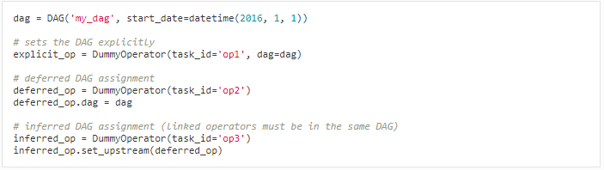
DAG Assignment
perators do not have to be assigned to DAGs immediately (previously dag was a required argument).
However, once an operator is assigned to a DAG, it can not be transferred or unassigned.
DAG assignment can be done explicitly when the operator is created, through deferred assignment, or even inferred from other operators.

Slide 15
Tasks
Once an operator is instantiated, it is referred to as a “task”.
The instantiation defines specific values when calling the abstract operator, and the parameterized task becomes a node in a DAG.
A task instance represents a specific run of a task and is characterized as the combination of a dag, a task, and a point in time.
Task instances also have an indicative state, which could be “running”, “success”, “failed”, “skipped”, “up for retry”, etc.
Task Instances

Slide 16
Workflows
DAG: a description of the order in which work should take place
Operator: a class that acts as a template for carrying out some work
Task: a parameterized instance of an operator
Task Instance: a task that 1) has been assigned to a DAG and 2) has a state associated with a specific run of the DAG
By combining DAGs and Operators to create TaskInstances, you can build complex workflows.

Slide 17
Additional Functionality
Hooks
Hooks are interfaces to external platforms and databases like Hive, S3, MySQL, Postgres, HDFS, and Pig.
Hooks implement a common interface when possible, and act as a building block for operators.
They also use the airflow.models.Connection model to retrieve hostnames and authentication information.
Hooks keep authentication code and information out of pipelines, centralized in the metadata database.

Slide 18
Pools
The list of pools is managed in the UI (Menu -> Admin -> Pools) by giving the pools a name and assigning it a number of worker slots.
Tasks can then be associated with one of the existing pools by using the pool parameter when creating tasks (i.e., instantiating operators).
The pool parameter can be used in conjunction with priority_weight to define priorities in the queue, and which tasks get executed first as slots open up in the pool.
The default priority_weight is 1, and can be bumped to any number

Slide 19
Queues
When using the CeleryExecutor, the celery queues that tasks are sent to can be specified. queue is an attribute of BaseOperator, so any task can be assigned to any queue.
The default queue for the environment is defined in the airflow.cfg’s celery -> default_queue. This defines the queue that tasks get assigned to when not specified, as well as which queue Airflow workers listen to when started.
Workers can listen to one or multiple queues of tasks.
When a worker is started (using the command airflow worker), a set of comma delimited queue names can be specified (e.g. airflow worker -q spark). This worker will then only pick up tasks wired to the specified queue(s).

Slide 20
XComs
XComs let tasks exchange messages, allowing more nuanced forms of control and shared state.
The name is an abbreviation of “cross-communication”. XComs are principally defined by a key, value, and timestamp, but also track attributes like the task/DAG that created the XCom and when it should become visible.
Any object that can be pickled can be used as an XCom value, so users should make sure to use objects of appropriate size.

Slide 21
Variables
Variables are a generic way to store and retrieve arbitrary content or settings as a simple key value store within Airflow.
Variables can be listed, created, updated and deleted from the UI (Admin -> Variables), code or CLI.
While your pipeline code definition and most of your constants and variables should be defined in code and stored in source control, it can be useful to have some variables or configuration items accessible and modifiable through the UI.

Slide 22
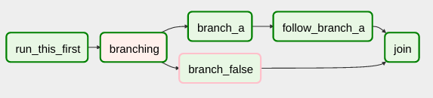
Branching
The BranchPythonOperator is much like the PythonOperator except that it expects a python_callable that returns a task_id.
The task_id returned is followed, and all of the other paths are skipped.
The task_id returned by the Python function has to be referencing a task directly downstream from the BranchPythonOperator task.

Slide 23
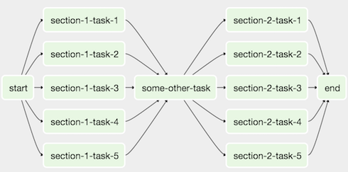
SubDAGs
SubDAGs are perfect for repeating patterns. Defining a function that returns a DAG object is a nice design pattern when using Airflow.
Airbnb uses the stage-check-exchange pattern when loading data.
Data is staged in a temporary table, after which data quality checks are performed against that table.
Once the checks all pass the partition is moved into the production table.

Slide 24
Trigger Rules
All operators have a trigger_rule argument which defines the rule by which the generated task get triggered.
The default value for trigger_rule is all_success and can be defined as “trigger this task when all directly upstream tasks have succeeded”.

Slide 25
Trigger Rules
Values that can be passed to any operator while creating tasks:
all_success: (default) all parents have succeeded
all_failed: all parents are in a failed or upstream_failed state
all_done: all parents are done with their execution
one_failed: fires as soon as at least one parent has failed, it does not wait for all parents to be done
one_success: fires as soon as at least one parent succeeds, it does not wait for all parents to be done
dummy: dependencies are just for show, trigger at will

Slide 26
DAG Runs
A DAG Run is an object representing an instantiation of the DAG in time.
Each DAG may or may not have a schedule, which informs how DAG Runs are created.
schedule_interval is defined as a DAG arguments, and receives preferably a cron expression as a str, or a datetime.timedelta object.

Slide 27
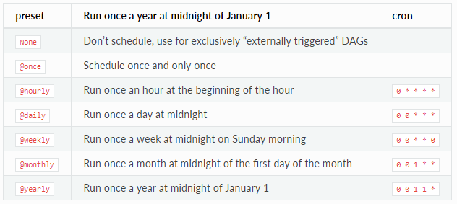
DAG Runs
Alternatively, you can also use one of these cron “preset”:

Slide 28
Backfill and Catchup
n Airflow DAG with a start_date, possibly an end_date, and a schedule_interval defines a series of intervals which the scheduler turn into individual Dag Runs and execute.
A key capability of Airflow is that these DAG Runs are atomic, idempotent items, and the scheduler, by default, will examine the lifetime of the DAG (from start to end/now, one interval at a time) and kick off a DAG Run for any interval that has not been run (or has been cleared). This concept is called Catchup.

Slide 29
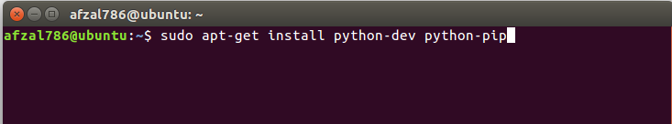
Installation
Prerequisites
Airflow is written in Python, so you have to install on your machine
Command

Slide 30
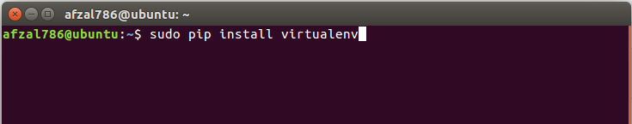
Installation
Prerequisites
After that install a virtual environment on your system
Command

Slide 31
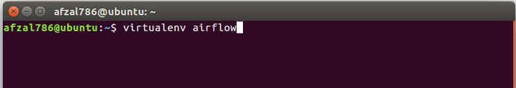
Installation
Let’s create a workspace directory
Command

Slide 32
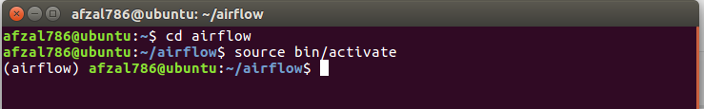
Installation
Activate the virtual environment by :
Command

Slide 33
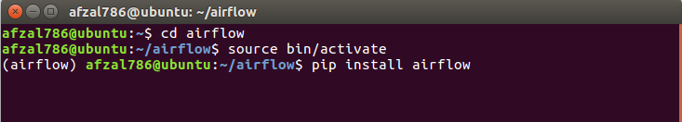
Installation
Now let’s install Airflow
Command
In case it fails type
sudo apt-cache search cython

Slide 34
Installation
Edit the ~/.bashrc file
Command

Slide 35
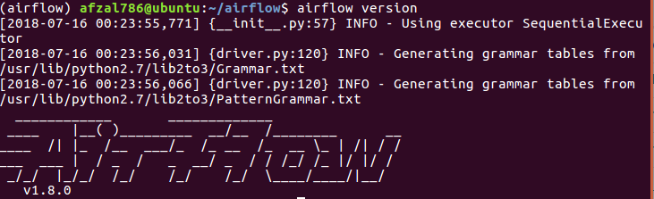
Installation
Check the airflow installation by typing
Command : airflow version

Slide 36
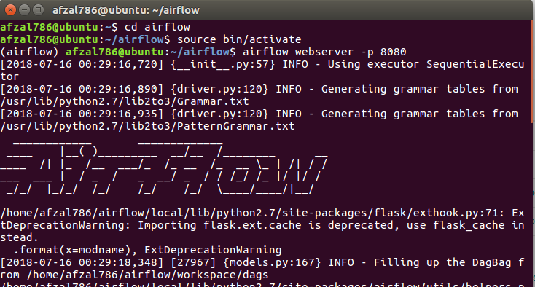
Getting started
To start the airflow webserver type the following command
airflow webserver –p 8080

Slide 37
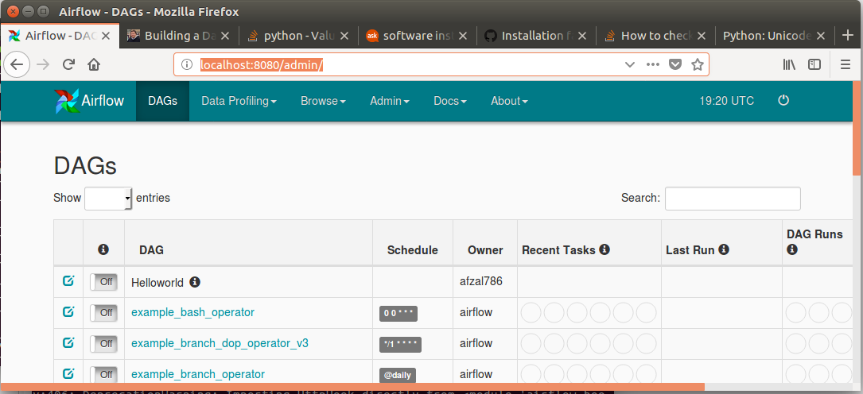
Getting started
You can view the airflow web UI by
http://localhost:8080/admin/

Slide 38
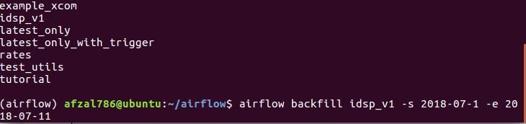
Getting started
You can run the dag by using the following command
airflow backfill <dag_id> -s <start_date> -e <end_date>

Slide 39
How to DAG
In Airflow, DAGs are defined as Python files. They have to be placed inside the dag_folder, which you can define in the Airflow configuration file. Based on the ETL steps we defined above, let’s create our DAG.
We will define three tasks using the Airflow PythonOperator. You need to pass your Python functions containing the task logic to each Operator using the python_callable keyword argument. Define these as dummy functions in a utils.py file for now. We’ll look at each one later.
We will also link them together using the set_downstream methods. This will define the order in which our tasks get executed.

Slide 40
How to DAG
Have a look at the DAG file. We have set the schedule_interval to 0 0 * * 2.
We have also set provide_context to True since we want Airflow to pass the DagRun’s context (think metadata, like the dag_id, execution_date etc.) into our task functions as keyword arguments.
At this point, you can go ahead and create a DAG run by executing airflow trigger_dag idsp_v1 on the command line.
Make sure you go to the Airflow UI and unpause the DAG before creating a DagRun.

Slide 41
Setup a data pipeline that takes currency exchange rates, stores them in PostgreSQL and then caches the latest exchange rates in Redis.

Slide 42
A Foreign Exchange Rate API
Open Exchange Rates has a "Forever Free" plan that offers an hourly rate feed with a US Dollar base. With this plan you can make 1,000 requests a month. Currency exchange markets operate 24 hours a day, 5 days a week.
They start at 10PM GMT on Sunday and run till 10PM GMT on Friday. This means rates in this feed should only change 520 times a month

Slide 43
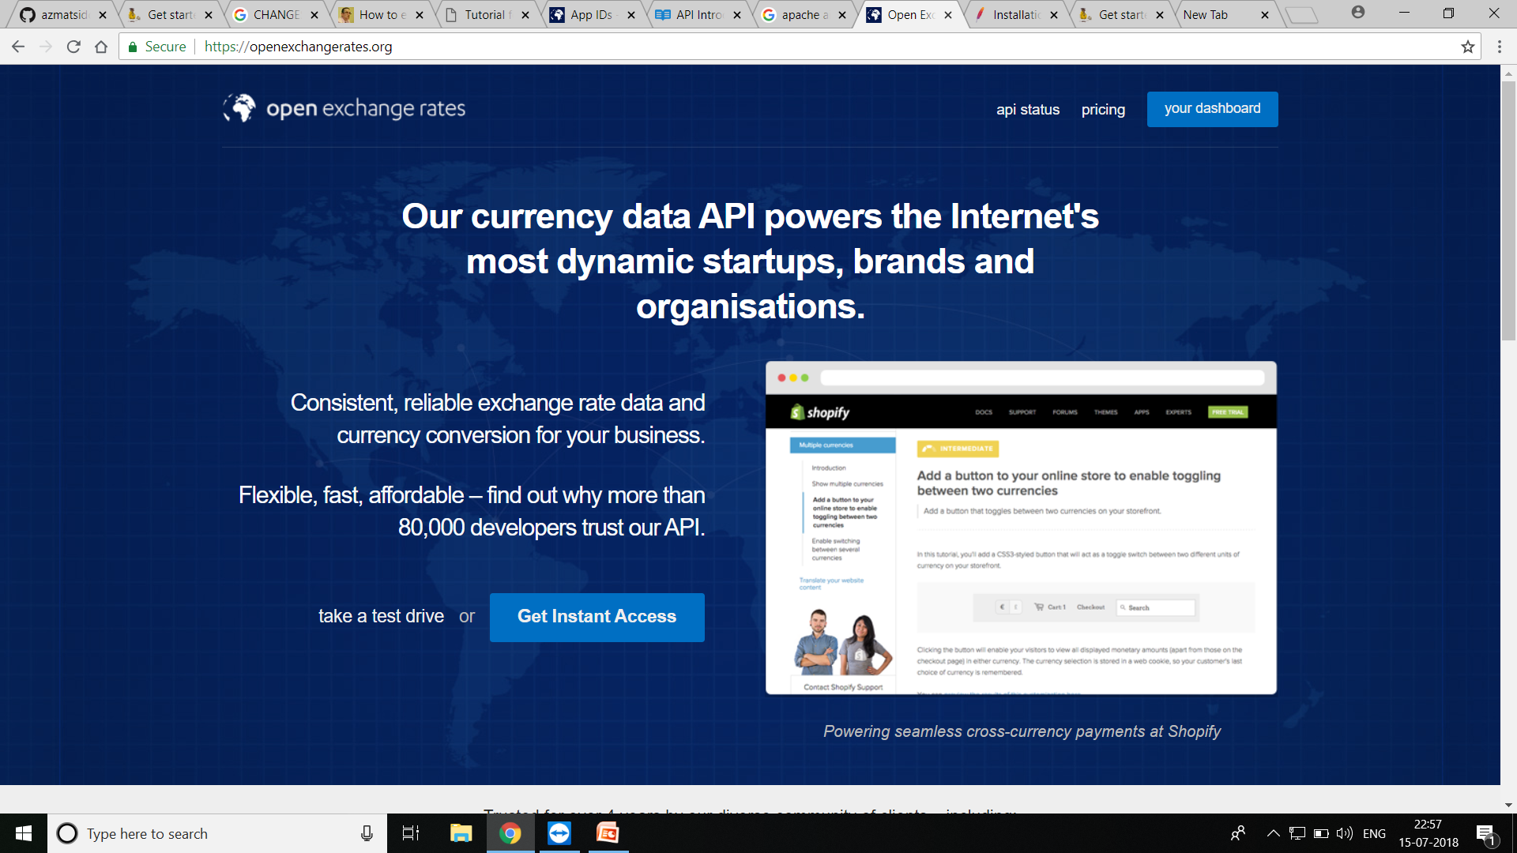
API

Slide 44
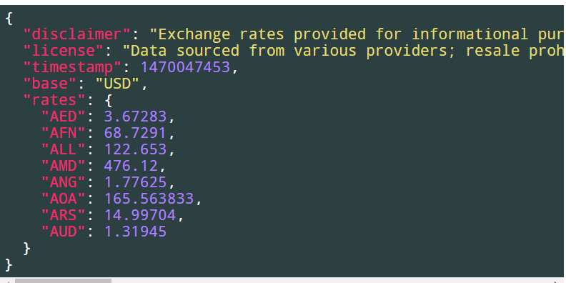
GET APP ID TO ACCESS API
Once you've signed up and got your Application ID the API call is pretty simple:
$ curl –S https://openexchangerates.org/api/latest.json?app_id=... | \ python -mjson.tool

Slide 45
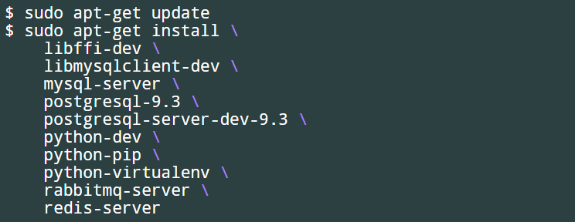
Installing Prerequisites
The following was run on a fresh Ubuntu 16.04 installation

Slide 46
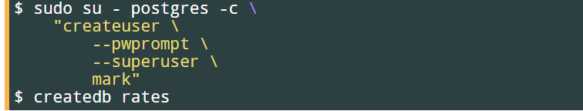
add Linux account to PostgreSQL's list of super users and then create the rates database which will store the exchange rate history.

Slide 47
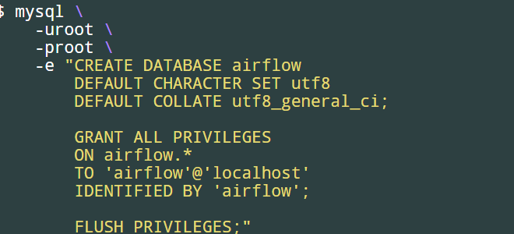
create the MySQL database for airflow.
The default Airflow configuration has "airflow" baked in as the username and password used to connect to MySQL.

Slide 48
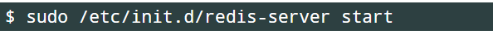
Start Redis
start Redis as it doesn't start automatically when you install it in Ubuntu via apt-get.

Slide 49
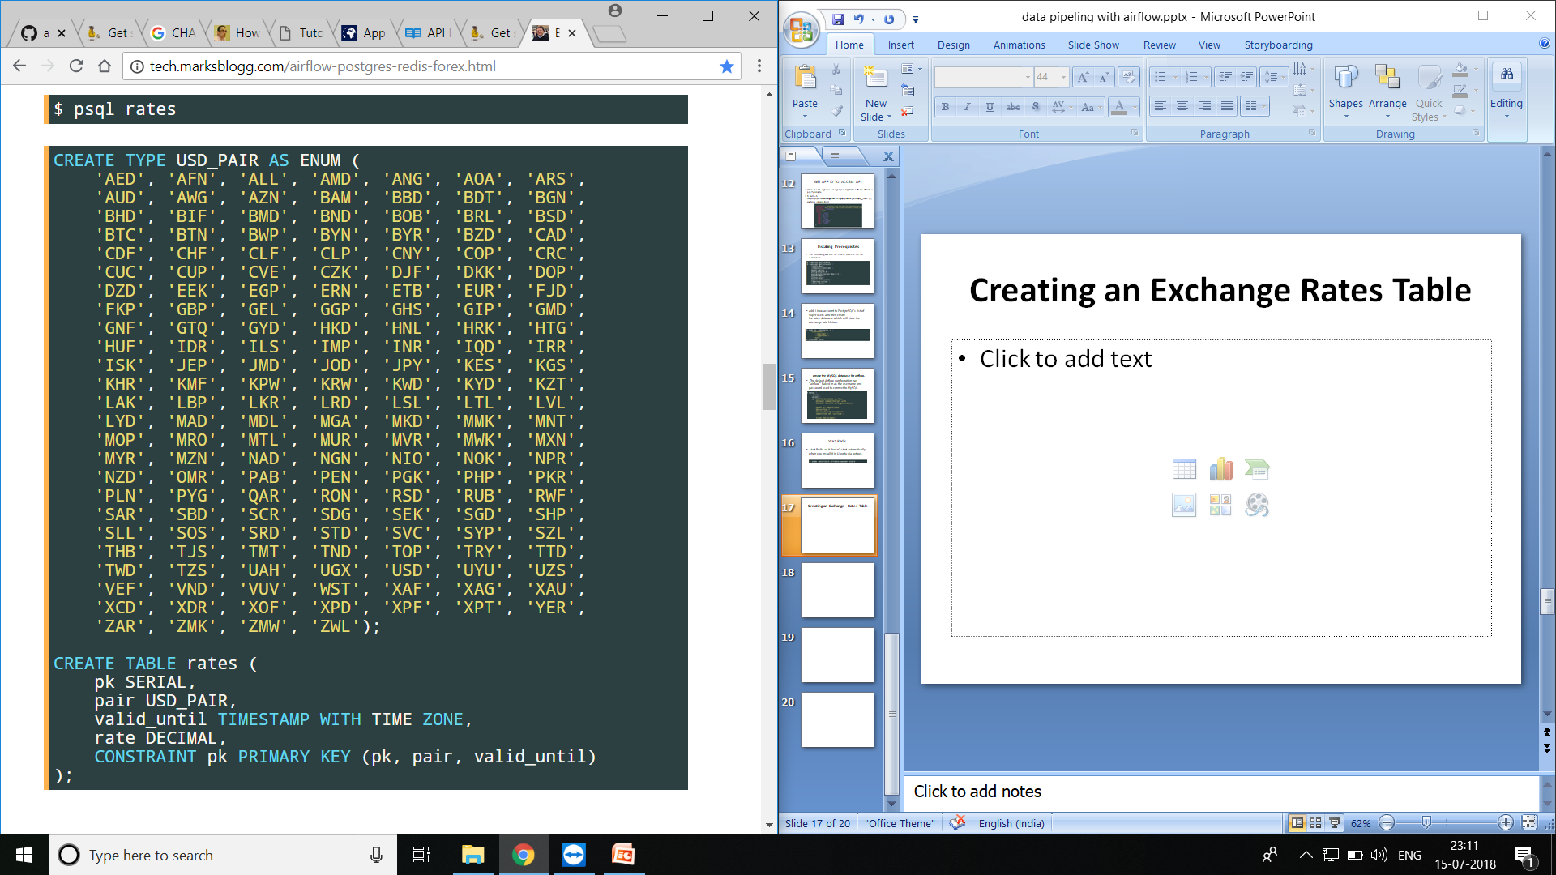
Creating an Exchange Rates Table

Slide 50
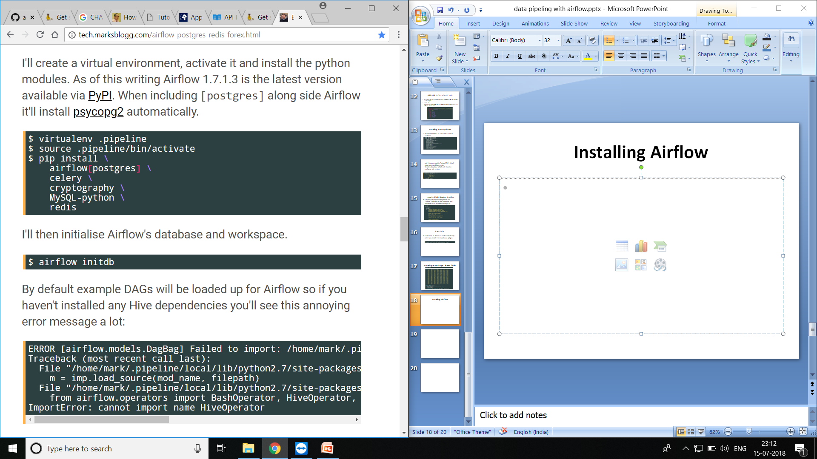
Installing Airflow

Slide 51
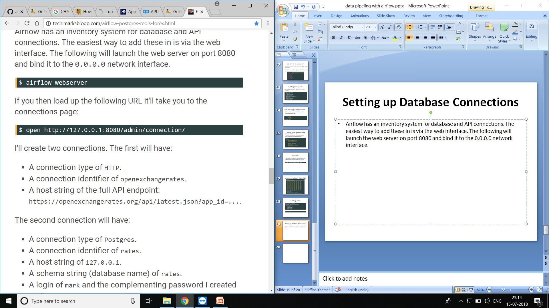
Setting up Database Connections
Airflow has an inventory system for database and API connections. The easiest way to add these in is via the web interface. The following will launch the web server on port 8080 and bind it to the 0.0.0.0 network interface.

Slide 52
Create two connections
1>>
A connection type of HTTP.
A connection identifier of openexchangerates.
A host string of the full API endpoint: https://openexchangerates.org/api/latest.json?app_id=....
2>>
A connection type of Postgres.
A connection identifier of rates.
A host string of 127.0.0.1.
A schema string (database name) of rates.
A login of mark and the complementing password I created earlier.

Slide 53
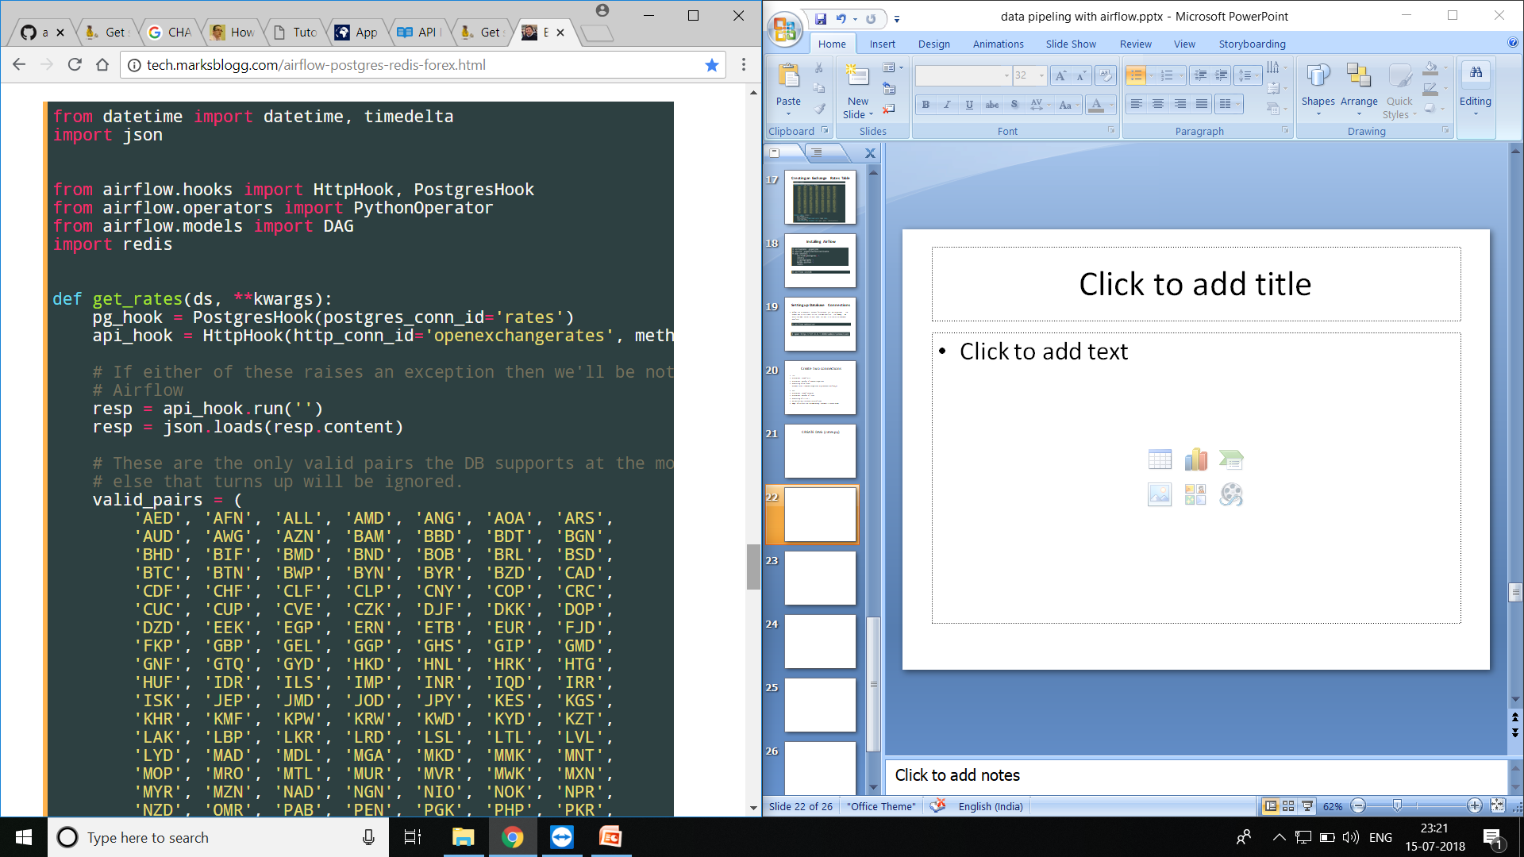
CREATE DAG (rates.py)

Slide 54
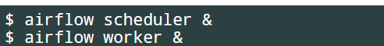
Launching the Scheduler & Worker
Airflow has two commands to getting jobs to execute, the first schedules the jobs to run and the second starts at least one worker to run jobs waiting to be taken on. This might seem like one command too many but if you're setting up a distributed system to take on a lot of work then having these divisions of responsibility helps out a lot.

Slide 55
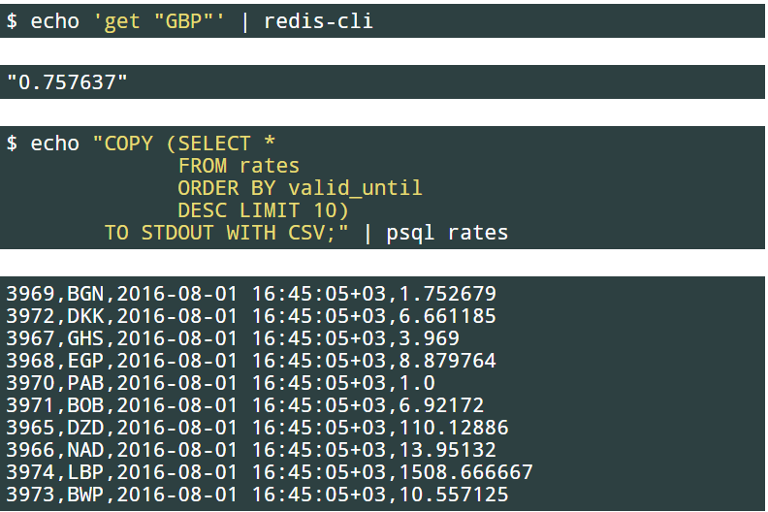
Airflow makes running a data pipeline very convenient. You can perform most debugging and auditing tasks from your browser. Once the DAG has run once successfully you'll be able to see the data in PostgreSQL and Redis:

Slide 56
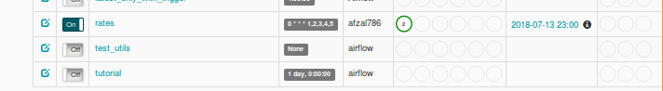
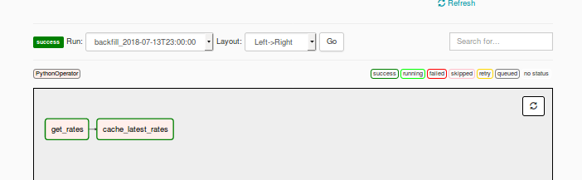
SAMPLE SCREENSHOTS:

Slide 57
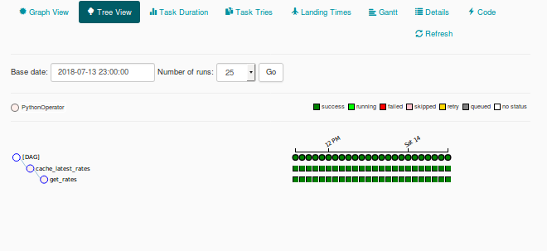

Slide 58
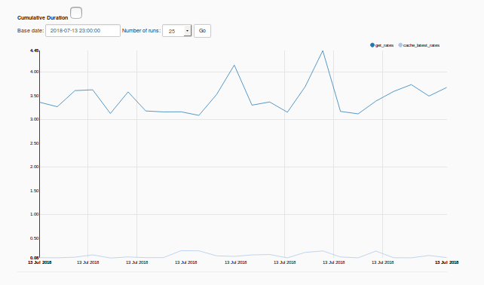

Slide 59
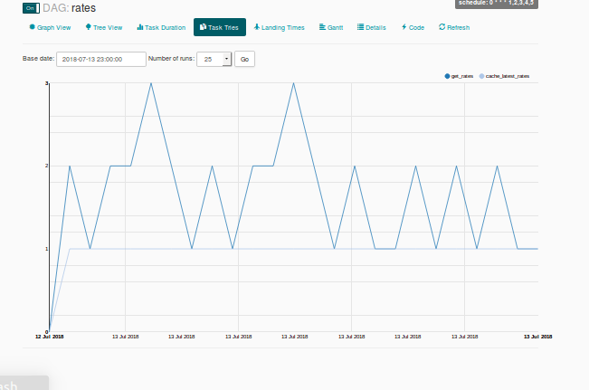

Slide 60
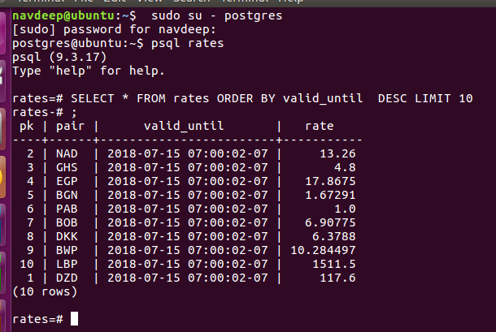
Output in DataBase

Slide 61


